Slide 1

Differentiating depression Daren Tan | dsi-sg-27

Slide 2
Problem statement
Listening Hearts, a not-for-profit organization that aims to provide free and accessible mental healthcare to those that require it, is being overwhelmed by demand for their services through their online portals
Commissioned to create a tool to assist their chatbot in identifying and prioritising at-risk clients
Notes:
Listening Hearts is trying to provide free and accessible mental health via online service
They are planning on using a chatbot to respond to queries and requests for help
Train a classifier for the chatbot to help it in distinguishing suicidal clients from dysthymia
BACKGROUND INFO: suicide risk is a scale: low-risk=passive suicidal ideation high-risk=active suicidal ideation

Slide 3
Methodology
Scrape submission posts from r/Depression and r/SuicideWatch
Clean data
Split the data into a training set and testing set
Train the data on the training dataset and compare its performance on the testing dataset
Tweak hyper parameters of model and clean data further to improve model performance

Slide 4
Assumptions
The subreddits have been well-moderated to the extent that there are no spam or off-topic posts
Posters are accurately conveying their emotions in their posts
Posters are aware of the existence of both subreddits
Notes:
No off-topic posts. Will harm the classifiers predictive ability if not caught.
Posters aren’t making things up.
Posters are posting to the correct subreddit i.e. depression posts in depression, sPosters are in touch with their emotions and are honest and sincere in their post suicidewatch posts in suicide watch i.e. the subreddits are classified correctly
Posters are aware of the existence of each subreddit
CLASSIFIED CORRECTLY

Slide 5

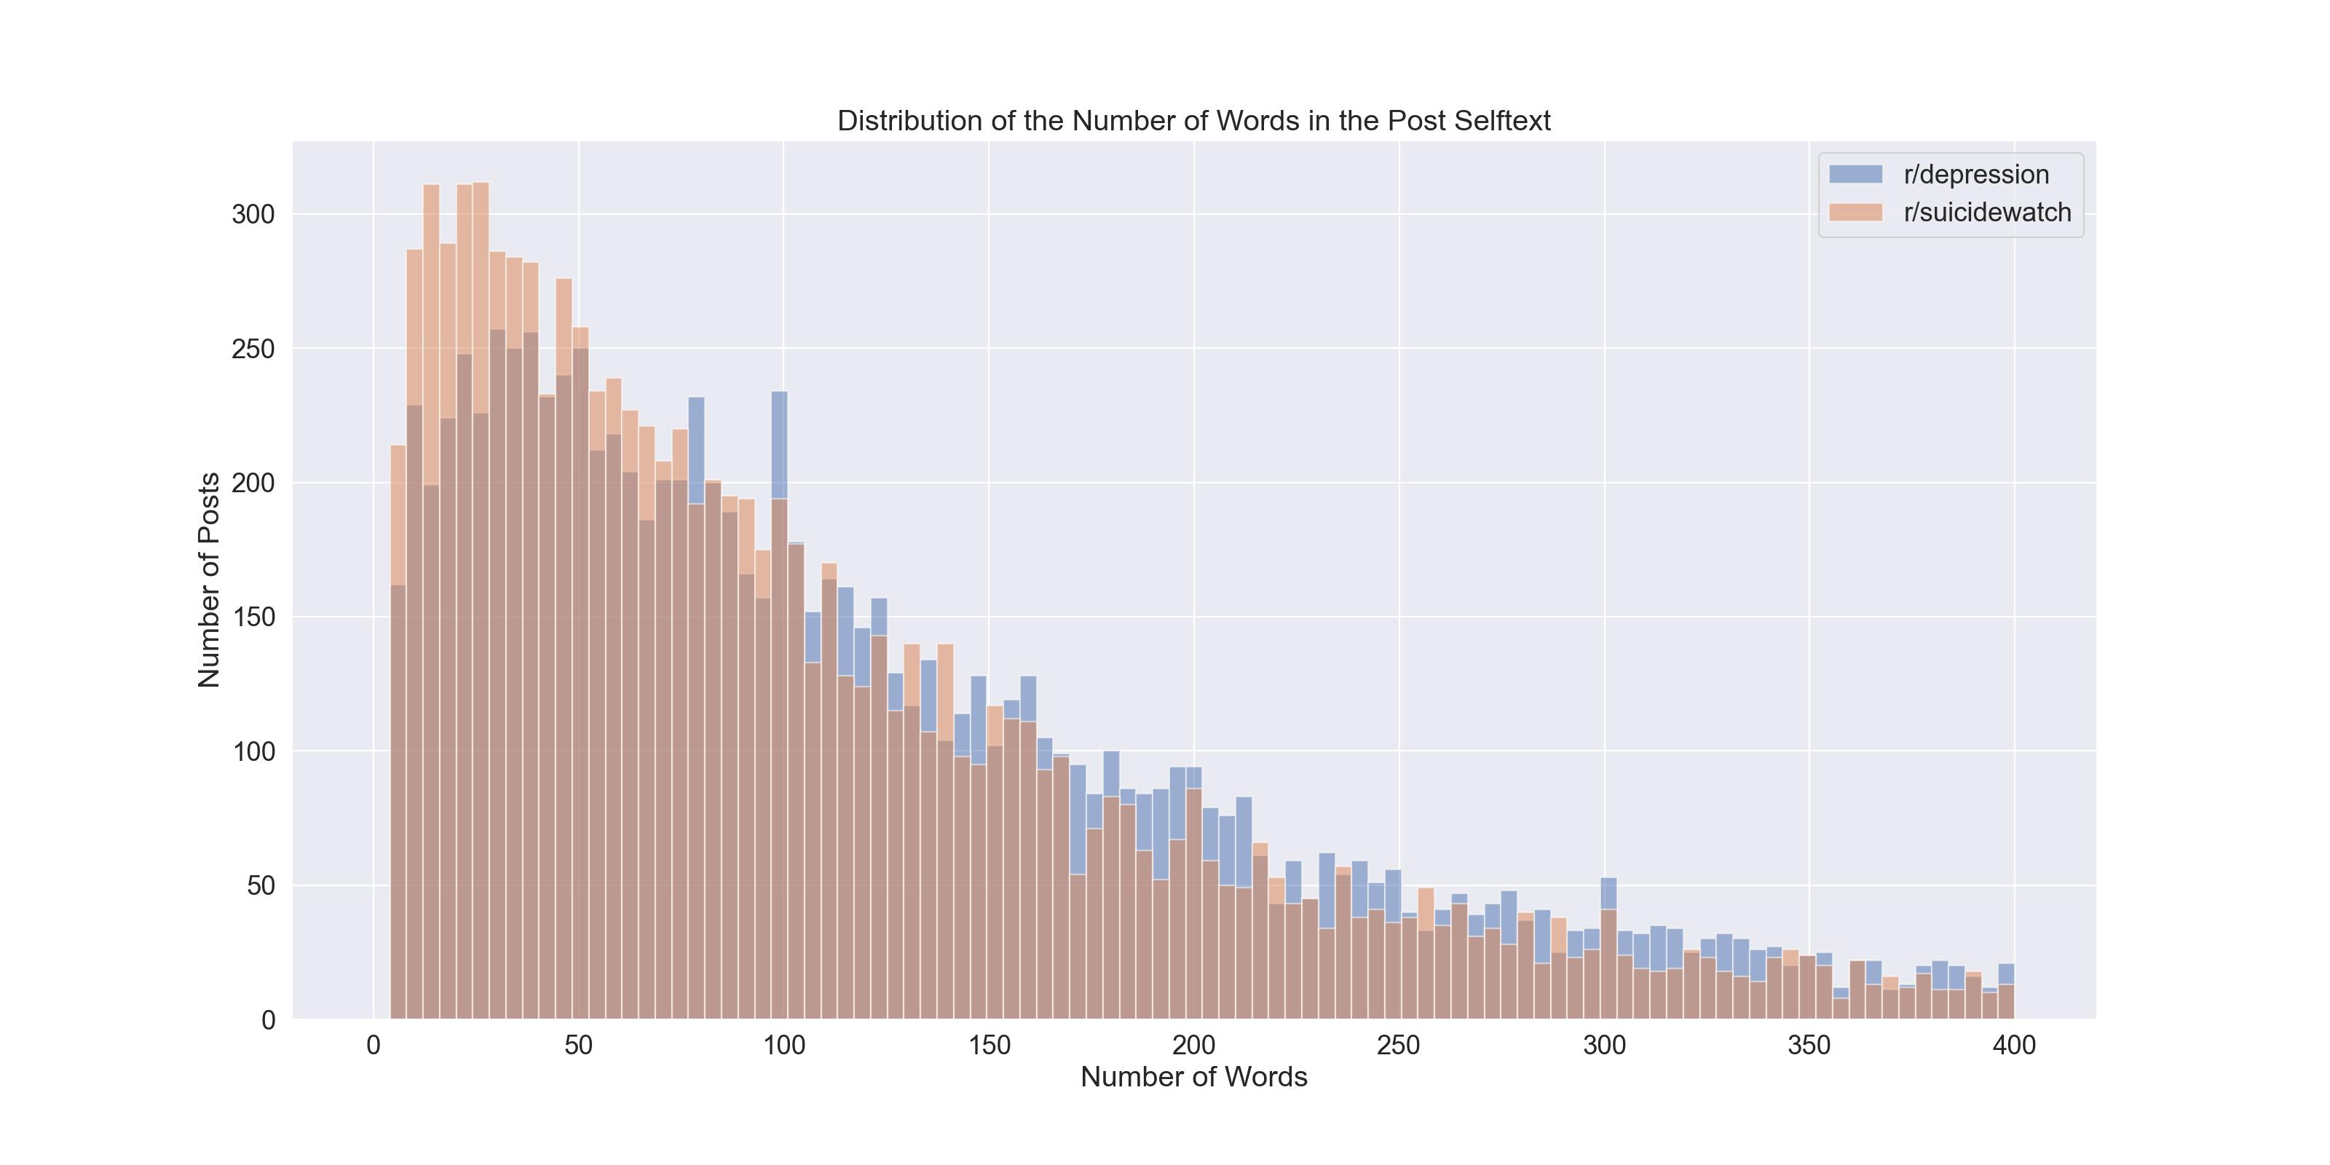
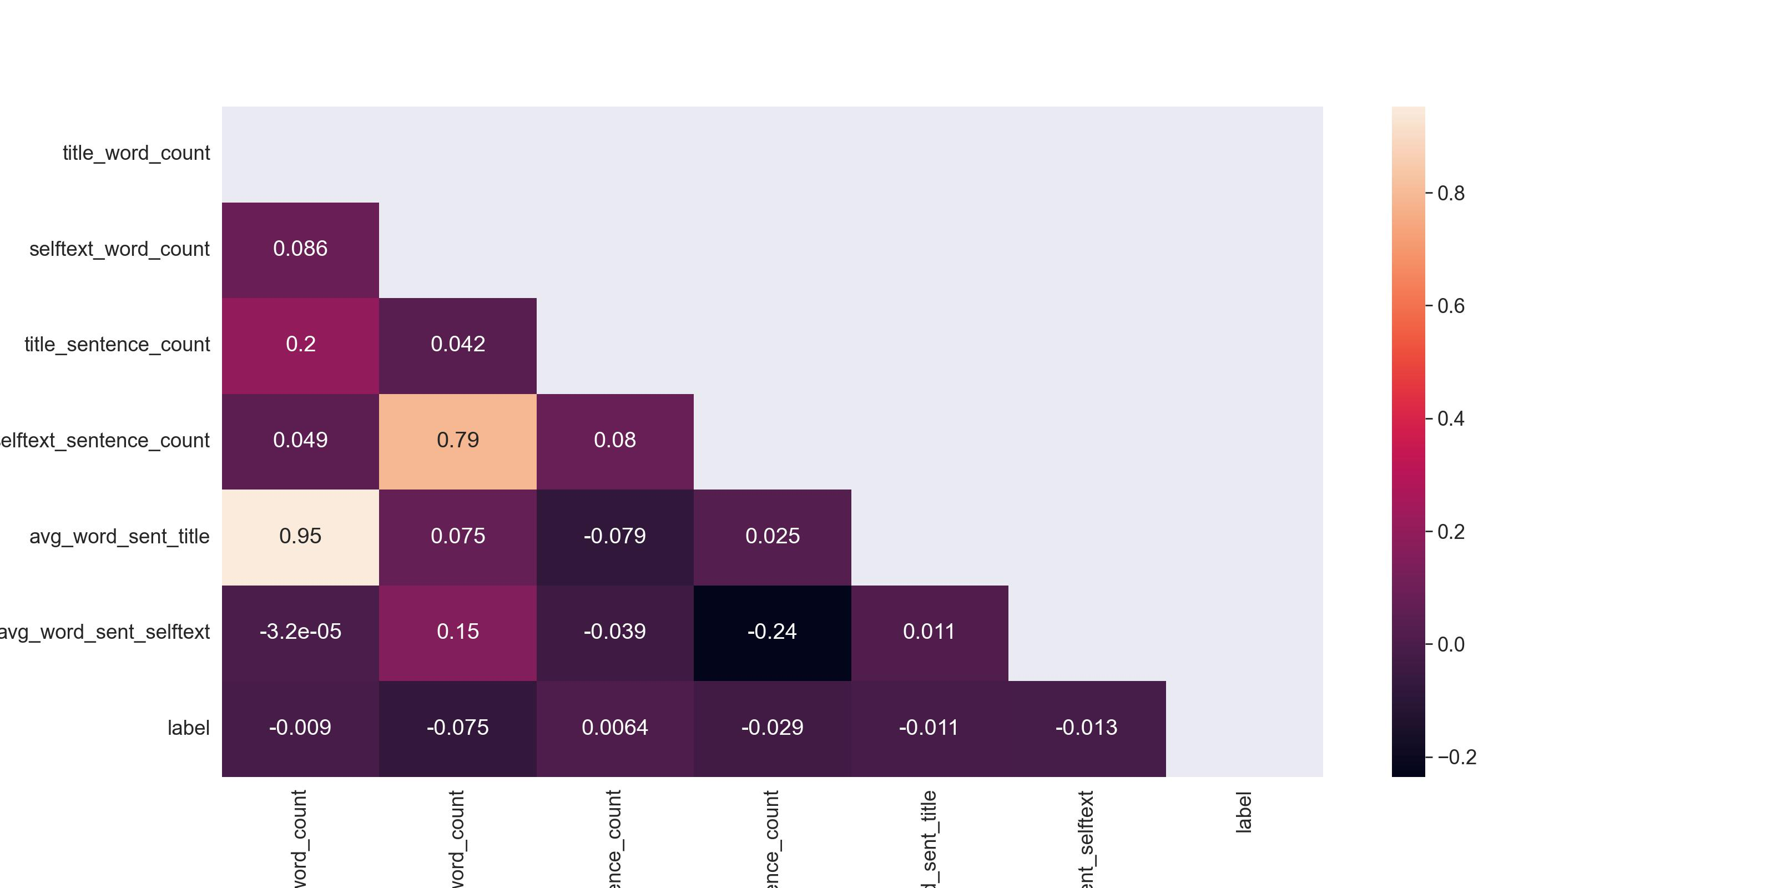
Exploratory Data analysis
Post features
Word count
Sentence
Words per sentence
Notes:
Only chart that did not have distributions looking like replicas of one another
Number of words in selftext
SuicideWatch posters tend to favour shorters posts

Slide 6
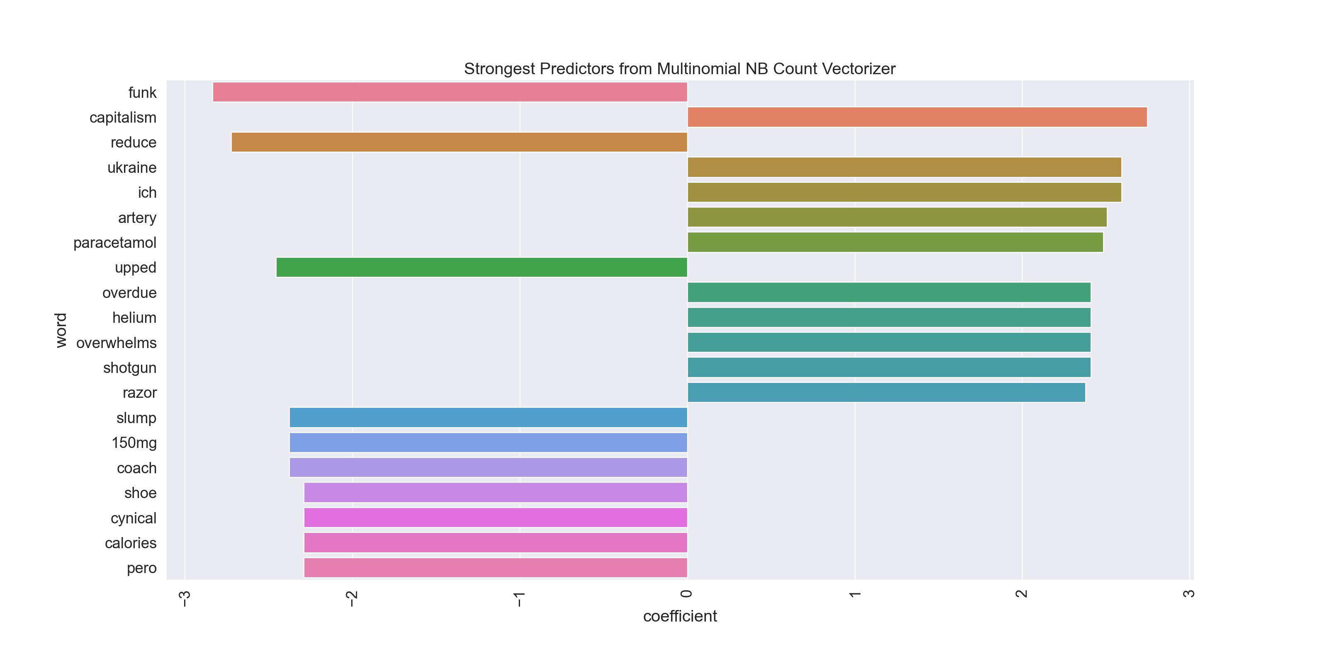
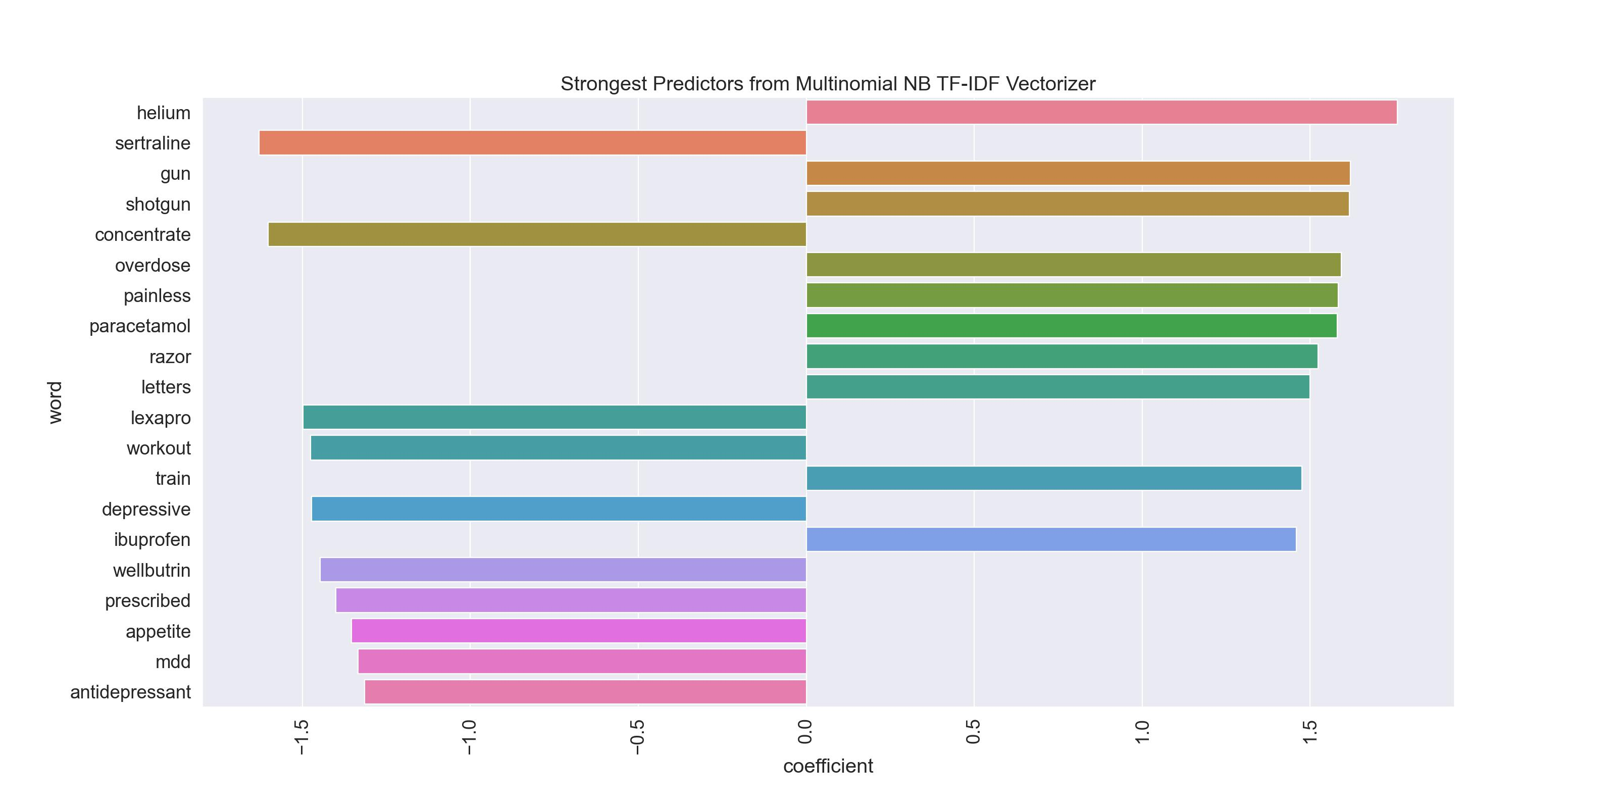
Exploratory Data analysis
Count Vectorizer vs. TF-IDF Vectorizer
71.3% accuracy on the training data 28% false omission rate
Notes:
One of the baseline models we used Multinomial Naïve Bayes
Words irrelevant without context i.e. Ich, pero, shoe, reduce, calories, overdue
When using count vectorizer
TFIDF assigned importance to words better
So use TFIDF despite CVEC giving a better score

Slide 7
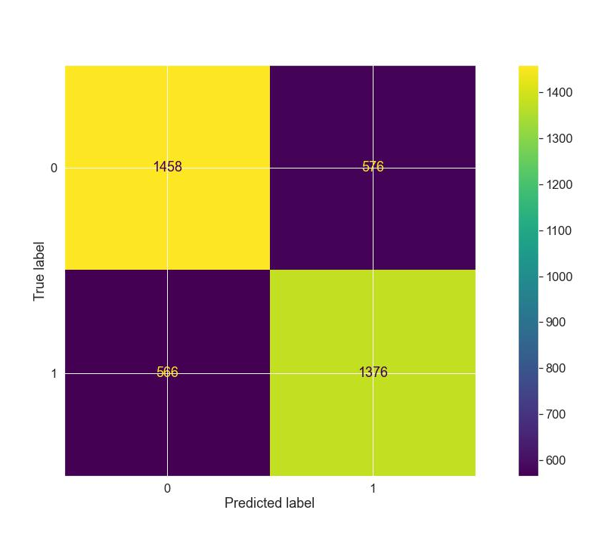
Final model (i)
Final model (i) 72.1% accuracy, 29.5% omission rate
Multinomial NB model with parameters:
Customized stopwords
Customized tokenizer
Optimised parameters:
Max_df=0.99
Min_df=0
Ngram=(1, 2)
10 fold Cross-validation
Notes:
Increase in accuracy of 0.8% but also increase in omission rate of 1.5% over the baseline model
False omission rate: change of a Suicidal when predicting Depression

Slide 8
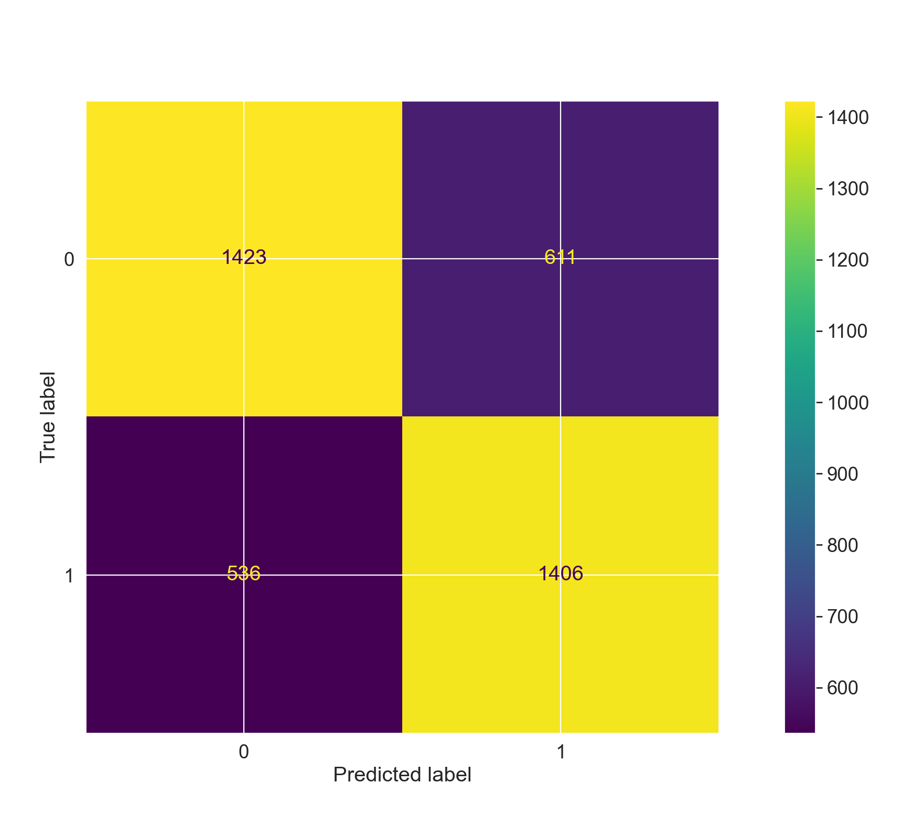
Final model (ii)
Final model (ii) 71.2% accuracy, 27.4% false omission rate
Random Forest model with parameters:
Customized stopwords
No tokenizer
Optimised parameters:
Max_df=0.95
Ngram=(1, 2)
Max_depth=86
Min_samples_leaf=5
10 fold Cross-validation
Notes:
Decrease in accuracy of 0.1% but also decrease in omission rate of 0.6% over the baseline model

Slide 9
Insights
Multinomial NB
Random Forests
Which model is better?
Accuracy of the models
False omission score of the models
Fit of the models
Notes:
MultiNB accuracy= 72.1%, , false omission rate = 29.5%
Random Forests accuracy= 71.2%, , false omission rate = 27.4%

Slide 10
Conclusions and recommendations
Classifier not commercially ready
Accuracy too low
False omission rate too high
Assumptions were too bold
Popularity of subreddits
More or better data
Better classified data
Notes:
Topics are extremely similar, so difficult to classify
Those that are suicidal tend to be depressed
Can be improved given more time and more data
Better if we had more concrete data that was professionally classified
Anonymous counselling data

Slide 11
Thank you for listening

